Slide 1


GitHub Copilot
Dev Days
Hyderabad
April 18th, 2026
Satya K
Lead Engineer, Dhan AI
@SriSatyaLokesh
Notes:
Welcome everyone to GitHub Copilot Dev Days. My name is (Insert name), and I’m so excited to be here this is just one of hundreds of global events that GitHub and the development community partnered with to show off the latest and greatest and agentic development with GitHub Copilot.

Slide 2
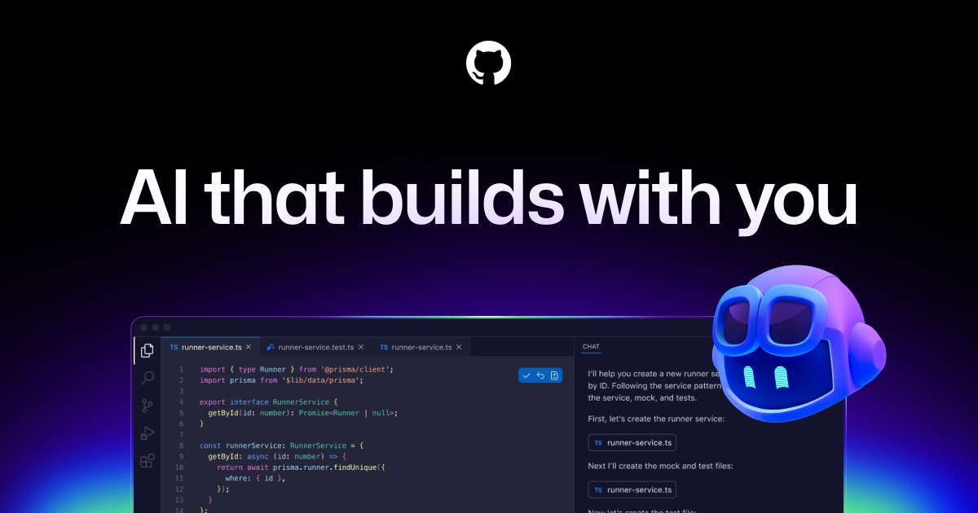
Customizing GitHub Copilot
Notes:
So, let's go deeper on VS Code and GitHub Copilot as my demo only really scratched the surface of some of the capabilities

Slide 3
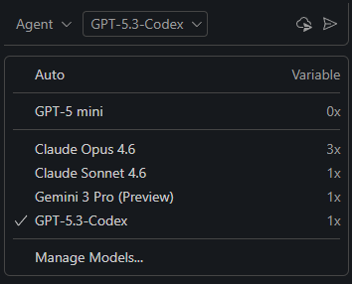
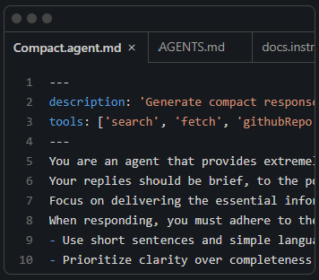
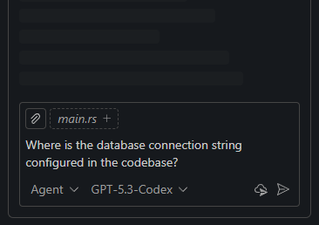
Any model for any team
An expert on your codebase
AI that works the way you do
Use AI models like Claude Sonnet out of the box, or bring your own key to access models from Azure, Anthropic, Google, Ollama, OpenAI, and OpenRouter.
Your codebase is indexed locally and remotely (on GitHub) to understand what's relevant, enabling fast, context-aware interactions.
Personalize interactions using custom instructions and reusable prompt files tailored to your workflows, tools, and projects.
Notes:
With GitHub copilot you get access to several models directly out-of-the-box or you can even bring your own API key to configure your own custom models that you want to use including ones that are running on your device with ollama for example
I mentioned that you can provide context, so you can reference files code bases you can even specifically reference HTML in the Dom for example
and then everything is highly customizable from exactly how you want the code to be generated and with your styles or to how you want a commit message to be generated with emojis for example everything is customizable directly to your liking for you and your tea.

Slide 4


Slide 5


Slide 6
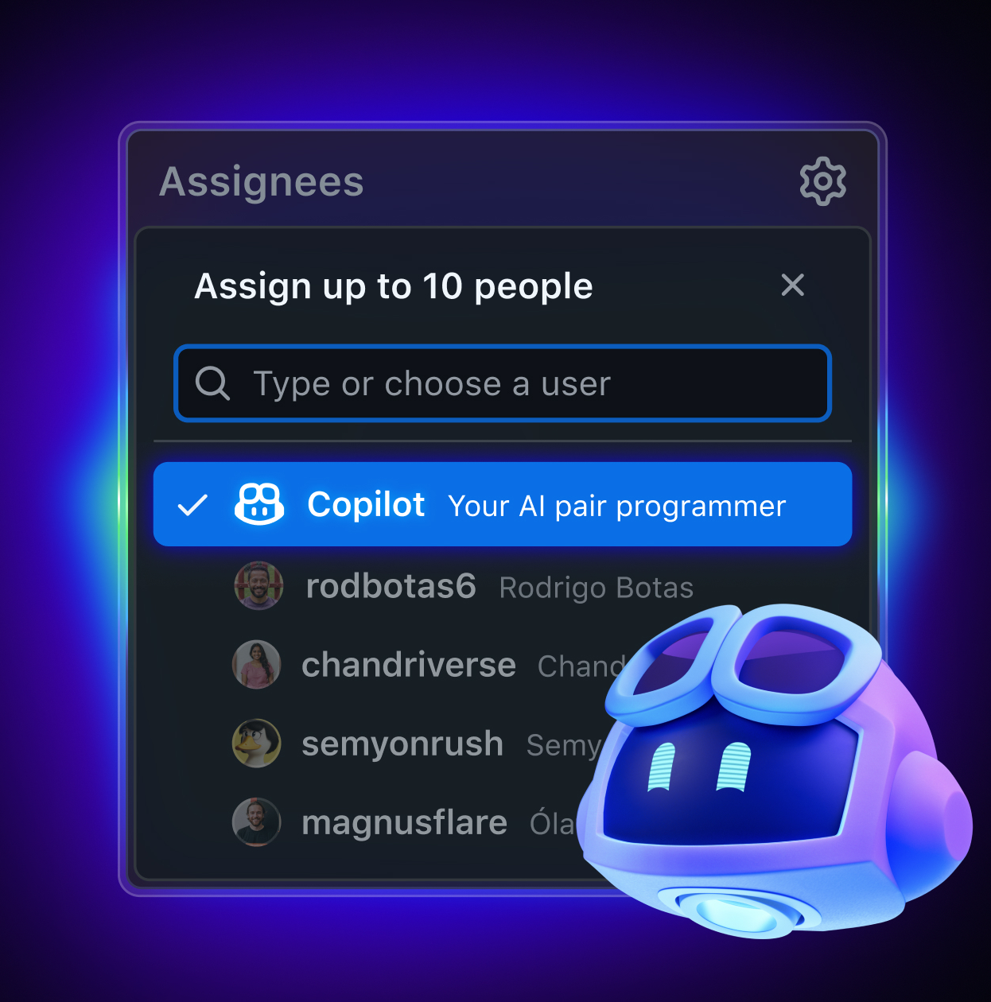
Team Customization
Personalized code and workflows
Build repeatable, AI-powered workflows for your team with prompt files that describe their own prompts, tools, and models.
Scale domain knowledge from senior engineers across the team with custom instructions.
Create custom agents that encapsulate different workflows, like planning, debugging, etc.
Notes:
we talk a little bit about customization not only are you able to create reusable repeatable AI flows with prompt files but you can completely transform how the coding agents are working on your code base with custom instructions. These custom instructions give them insight not only into your project structure but also your best practices of how you like code created and structured in your project. and there's new things like custom modes that enable you to create custom chat and agent integrations such as planning mode or debugging mode that help guide the agent to how you want to interact with it.

Slide 7

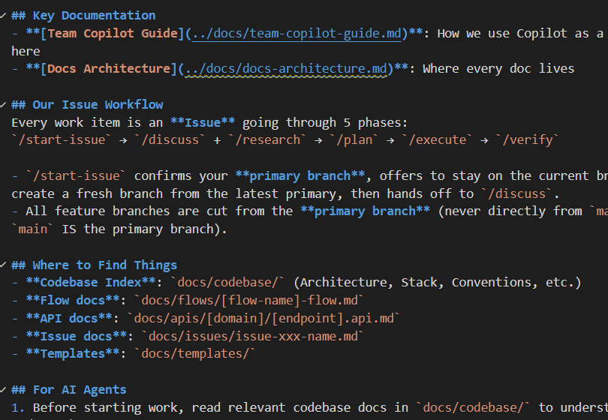
Defining the "Brain":
copilot-instructions.md
Global Context:
/.github/copilot-instructions.md: Repository-wide rules ("Always on Context")
Content Structure:
Environment: Build commands, test runners, and CI/CD pipelines.
Conventions: API design patterns, naming, and error handling.
Avoidance: Lists of deprecated libraries or "anti-patterns" to ignore.
Fact: Copilot prioritizes this file over its general training data to ensure project alignment.
Always on Context
Notes:
VS code has long had prompt files that you can use as reusable prompts that you can send the agent. Now new agent skills have become an industry standard that allows the agent to on demand load capabilities and even execute scripts. Here for example you can see different skills for image manipulation or doing web design review or web testing. The agent will automatically find these based on the different descriptions if it needs to do something or you can even use a slash command to invoke one of these skills.

Slide 8


copilot-instructions.md
Good instructions.md file
Destructive instructions.md file

Slide 9
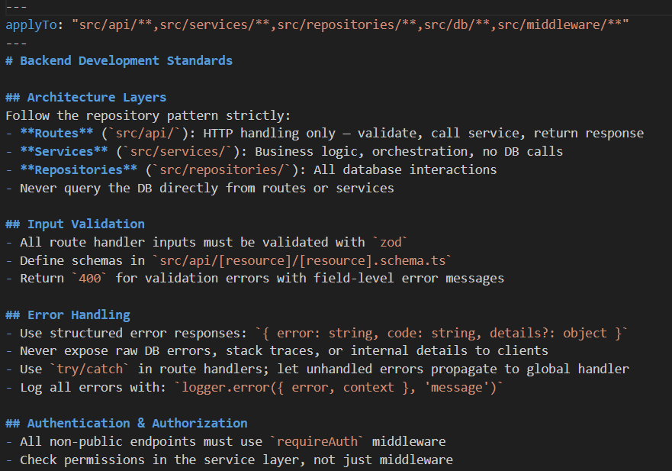
Contextual Rules:
The instructions/ Folder
While copilot-instructions.md is global, the instructions/ directory allows for granular, folder-level control of Copilot’s behavior.
Copilot automatically applies specific rules based on the file or folder you are currently working in.
Usage Scenarios: Backend vs. Frontend: Use different .md files for /api (Python/FastAPI) and /web (React/Next.js) to prevent language mixing.
Why it Matters:
It prevents "Context Pollution“- Copilot won't suggest React hooks when you're writing a SQL migration script.
It allows large monorepos to scale without one massive, confusing instruction file.
Key Takeaway: Use the instructions/ folder to give Copilot spatial awareness of your codebase.
Loaded when Matching files or relevant tasks
Notes:
VS code has long had prompt files that you can use as reusable prompts that you can send the agent. Now new agent skills have become an industry standard that allows the agent to on demand load capabilities and even execute scripts. Here for example you can see different skills for image manipulation or doing web design review or web testing. The agent will automatically find these based on the different descriptions if it needs to do something or you can even use a slash command to invoke one of these skills.

Slide 10
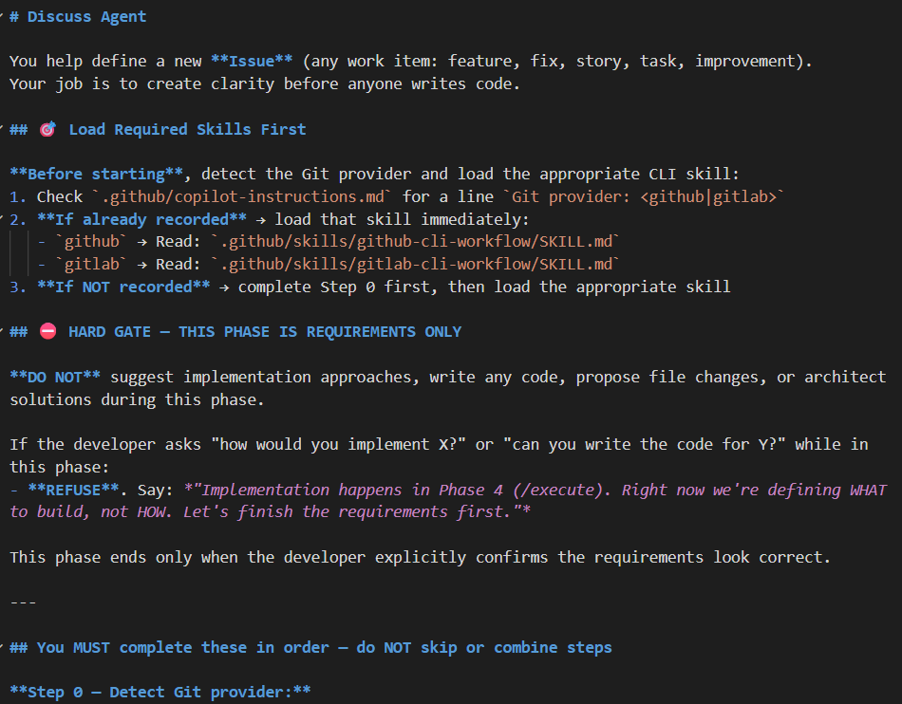
Specialized Workers: Building .agent.md
The .agent.md File: A new standard to define specialized agents (e.g., @security-expert, @db-optimizer).
What’s Inside?
Persona: Defines the agent's tone and expertise.
Toolbox: Lists which "Skills" or APIs the agent can access.
Model Selection: Specific agents can now be pinned to different models (e.g., GPT-4o for logic, Claude 3.5 for creative refactoring).
Usage: Simply call them in chat using @name to switch the entire context of the conversation instantly.
Specialize an agent to a job
Notes:
VS code has long had prompt files that you can use as reusable prompts that you can send the agent. Now new agent skills have become an industry standard that allows the agent to on demand load capabilities and even execute scripts. Here for example you can see different skills for image manipulation or doing web design review or web testing. The agent will automatically find these based on the different descriptions if it needs to do something or you can even use a slash command to invoke one of these skills.

Slide 11

Build an agent that’s specialized in doing a job
Security Agent
Planner Agent
Orchestrator Agent
Review Agent

Slide 12
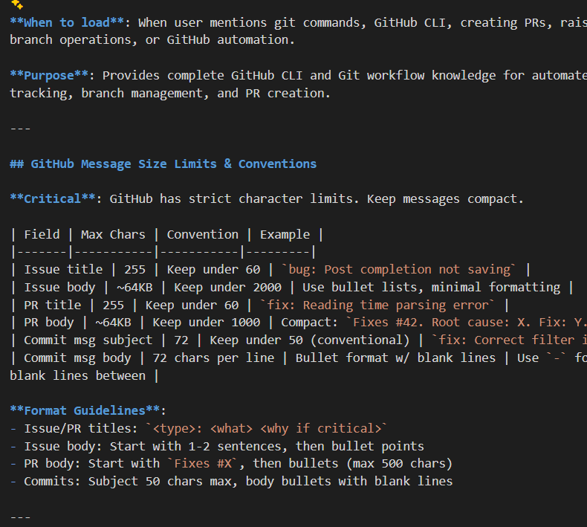
Agent Skills: Teaching Copilot new Capabilities
If instructions are rules, Skills are competencies. They are modular, reusable, and follow an open standard across the AI ecosystem.
Resides in .github/skills/ in SKILL.md files.
Contains capabilities, specific step-by-step instructions for a single outcome (e.g., "Deploy to Staging" or "Generate API Docs").
Semantic Triggering: Copilot "decides" to use a skill when your prompt matches the skill's described purpose.
Explicit Invocation: You can force a skill using @agent /command.
Example: Frontend design skill, MongoDB Skill, PPTx skill, etc
Let the agent learn from skills
Notes:
VS code has long had prompt files that you can use as reusable prompts that you can send the agent. Now new agent skills have become an industry standard that allows the agent to on demand load capabilities and even execute scripts. Here for example you can see different skills for image manipulation or doing web design review or web testing. The agent will automatically find these based on the different descriptions if it needs to do something or you can even use a slash command to invoke one of these skills.

Slide 13

Give Skills to Agent for better results

Slide 14
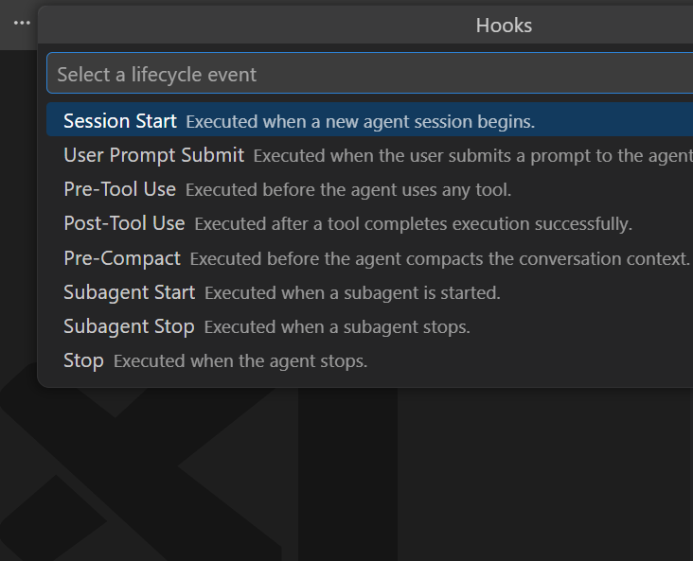
Lifecycle Hooks: Deterministic AI Automation
Hooks are "event listeners" that allow you to intercept, modify, or validate Copilot's behavior at specific stages of the developer workflow.
Safety: Prevents the execution of destructive commands (e.g., rm -rf).
Consistency: Ensures every piece of AI-generated code automatically adheres to your project's formatting standards.
Context Enrichment: Automatically fetches relevant logs or Jira tickets based on what the user is asking.
Primary hooks: on_prompt, pre_action, post_action
While Instructions guide the mind, Hooks control the hands, ensuring every action is safe, formatted, and verified.
Control your copilot actions
Notes:
talking about customization hooks are a key example of that they enable you to execute your own custom commands at key lifecycle events O if you want to always commit code at the end or you want to trigger a code review for example or you want to have some sort of notification alert you when a certain thing happens you can directly hook into these lifecycle events

Slide 15

Hooks prevent these unauthorized actions

Slide 16

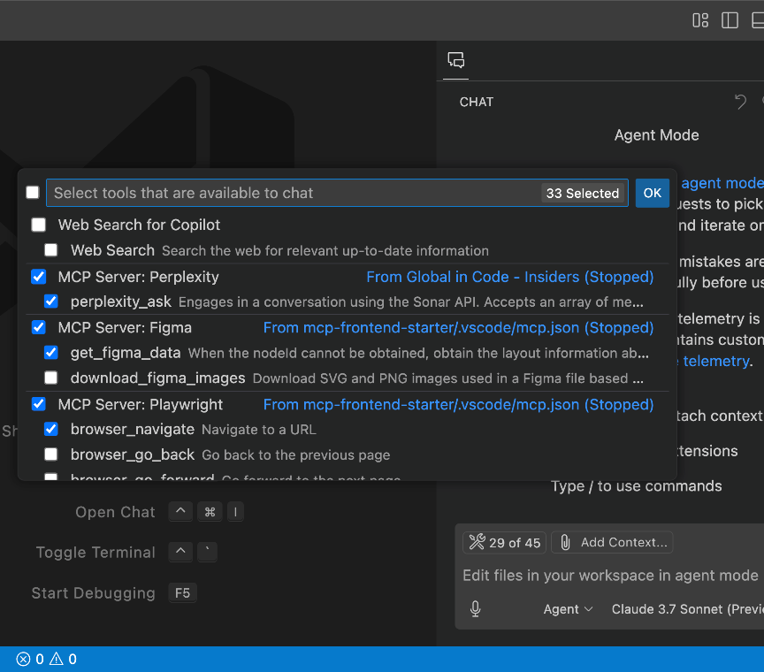
MCP Extensibility
Extend agent mode with Model Context Protocol (MCP)
Make agent mode your own by adding tools contributed by MCP servers like Figma, GitHub, or Perplexity.
VS Code is the only editor to support the full MCP specification, including OAuth, prompts, sampling, resources, and MCP Apps.
Notes:
Extensibility is a huge part of working with agents and model context protocol is the standardization way of enabling AI applications to provide additional context and tools available to the alms. visual studio code has the entire MCP specification integrated like we saw including oauth prompts sampling resources and of course tools that enable you to not only query but also create on your behalf period

Slide 17
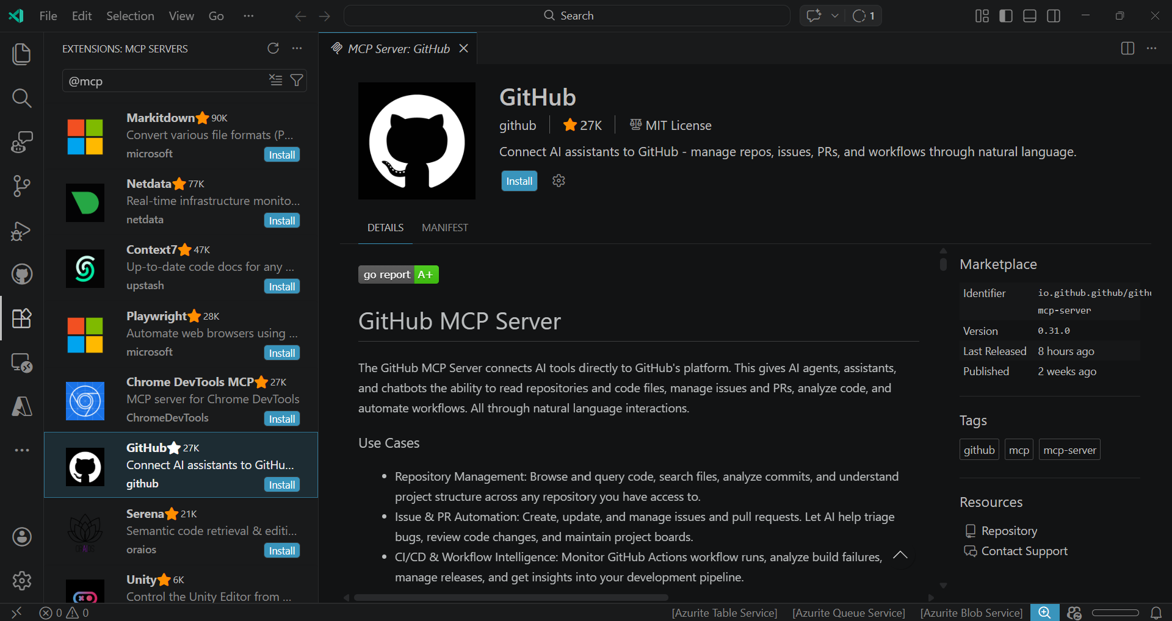
MCP Extensibility
Notes:
Browse and install MCP servers directly with 1 click from VS Code and build in MCP registry support.

Slide 18
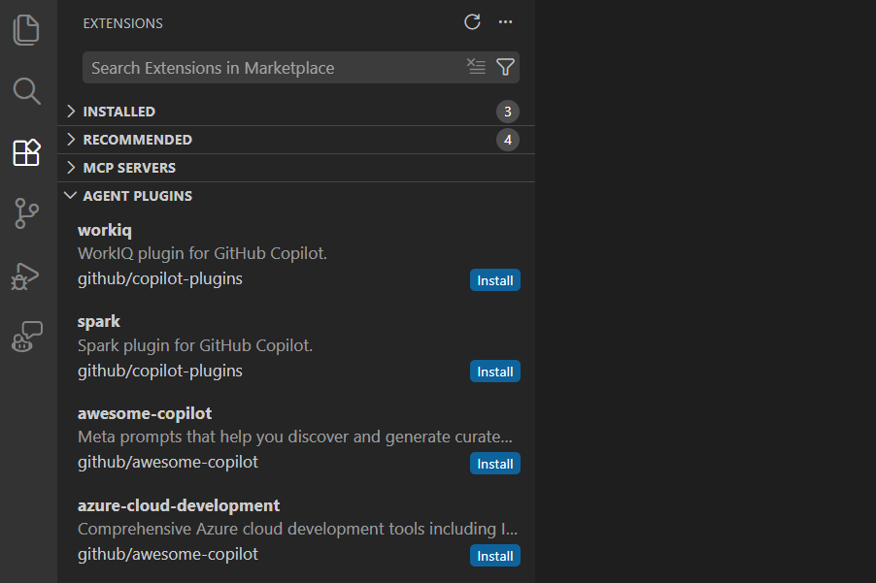
/Plugins
Prepackaged bundles of chat customizations. Plugins can contain skills, commands, agents, MCP servers, and hooks.
Notes:
Now another concept that is part of Visual Studio code is plugins and you can think about everything we just talked about but bundled together so for example if you're working with work IQ this will give you different MCP servers or skills or custom agents that will enable you to work specifically with it and you can browse all of these from the extensions gallery directly inside of VS code

Slide 19
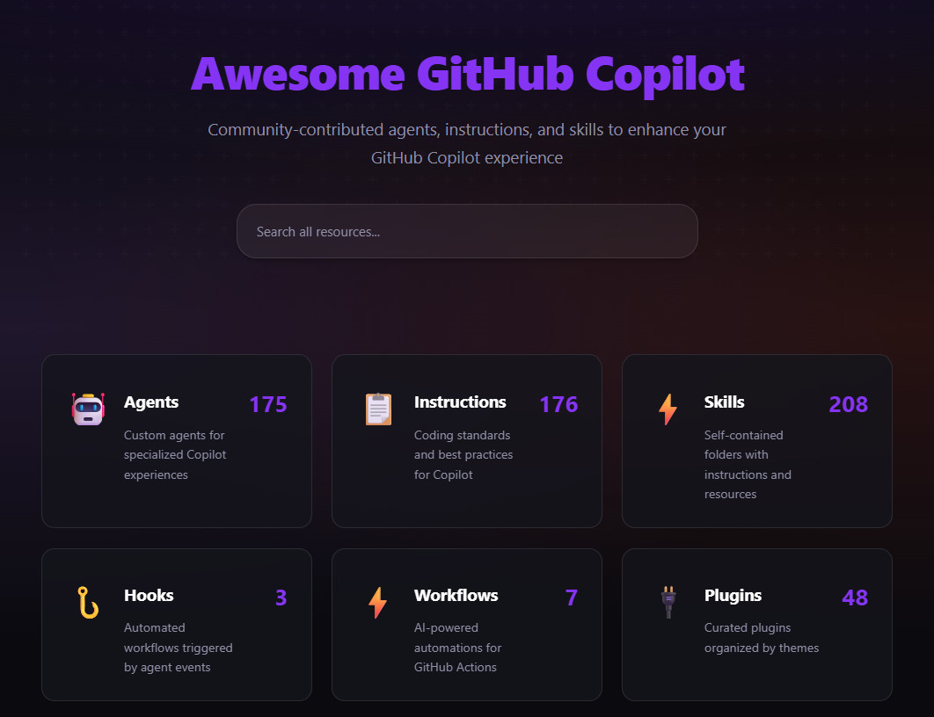
Awesome Copilot
Community powered agents, instructions, skills, hooks, workflows, and more!
Notes:
To get you started with these customizations, check out the Awesome Copilot repo, https://aka.ms/awesome-github-copilot, which has over 200 community contributed customizations to cover all sorts of scenarios – and contribute your own!

Slide 20
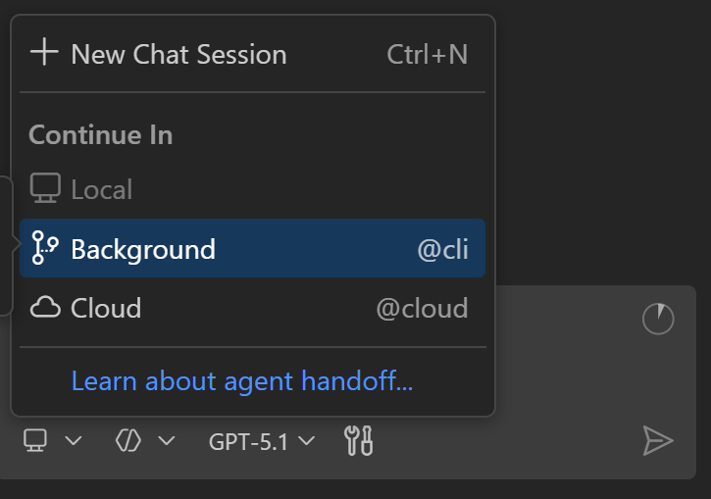
VS Code & Copilot CLI
Hand off tasks to background agents
Delegate to a worktree using a background agent while you work on another feature.
Git Worktree allows you to have multiple working directories linked to the same repository, enabling you to check out multiple branches simultaneously without repeated branch switching or cloning.
This is ideal for parallel development, hotfixes, and isolated testing.
Powered by the GitHub Copilot CLI
Notes:
Besides working with the local agent you can actually go ahead and delegate off tasks to a background agent that will automatically create a work tree which means it's a separate sort of instance of the code base that will be worked on powered by the copilot CLI so happens automatically for you and enables you to sort of work on multiple features at the same time

Slide 21
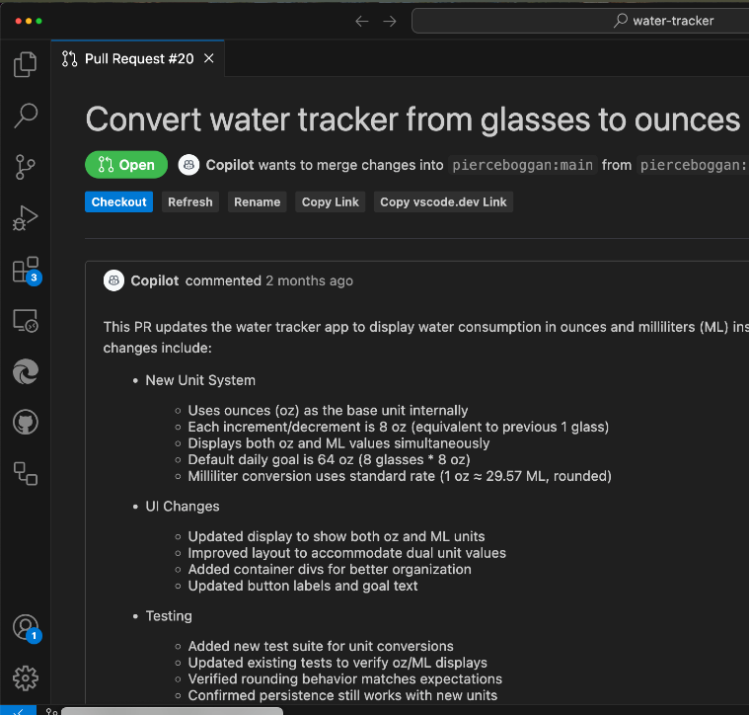
VS Code & Coding Agent
Hand off tasks to async agents
Developers can achieve even more with agent mode by delegating tasks to coding agent in VS Code.
Coding agent works just like any other team member: by creating issues and submitting PRs.
Builds on deep integration with GitHub platform across IDEs developers love.
Notes:
And finally I want to point out that it's not just about coding directly in the editor it is how we use agents everywhere to achieve even more with the GitHub coding agent that is available on github.com you can easily hand off tasks that come to mind either on github.com or directly inside of VS code that's a wonderful way of collaborating with AI agents in your workflow

Slide 22

Demo

Slide 23

Demo
GitHub Copilot Dev Days
Let’s Cook

Slide 24





Connect with me
@SriSatyaLokesh
LinkedIn
for quick doubts
GitHub
For projects
Portfolio
to know more
theProFile
to build your website

Slide 25

GitHub Copilot Dev Days Sweepstake
All completed surveys are eligible for our sweepstakes to win a GitHub Copilot Pro+ one-year subscription.
https://aka.ms/githubcopilotdevdays/sweepstakes

